Slide 1
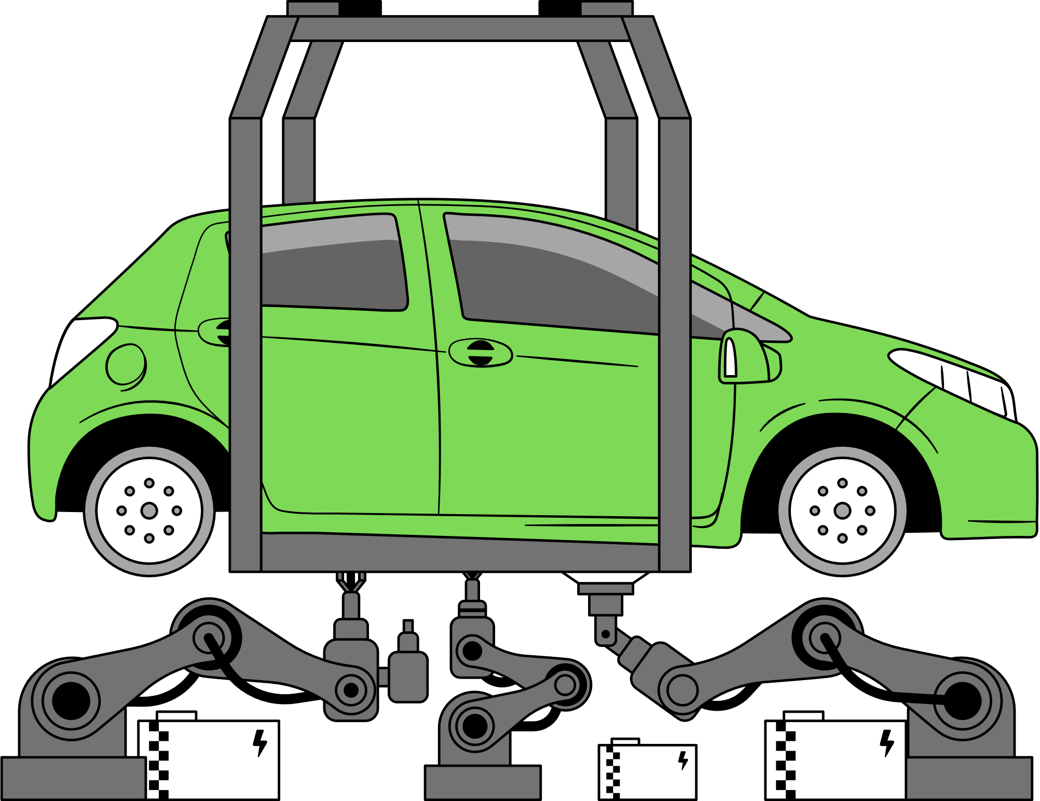

REPAIR RECOMMENDATION SYSTEM
AUTOSHOPIQ
Presented By: Team 1
Yash Parihar
Abhir Shah
Nimisha Ekka
(Project Manager)
(Sponsor Liaison)
1

Slide 2
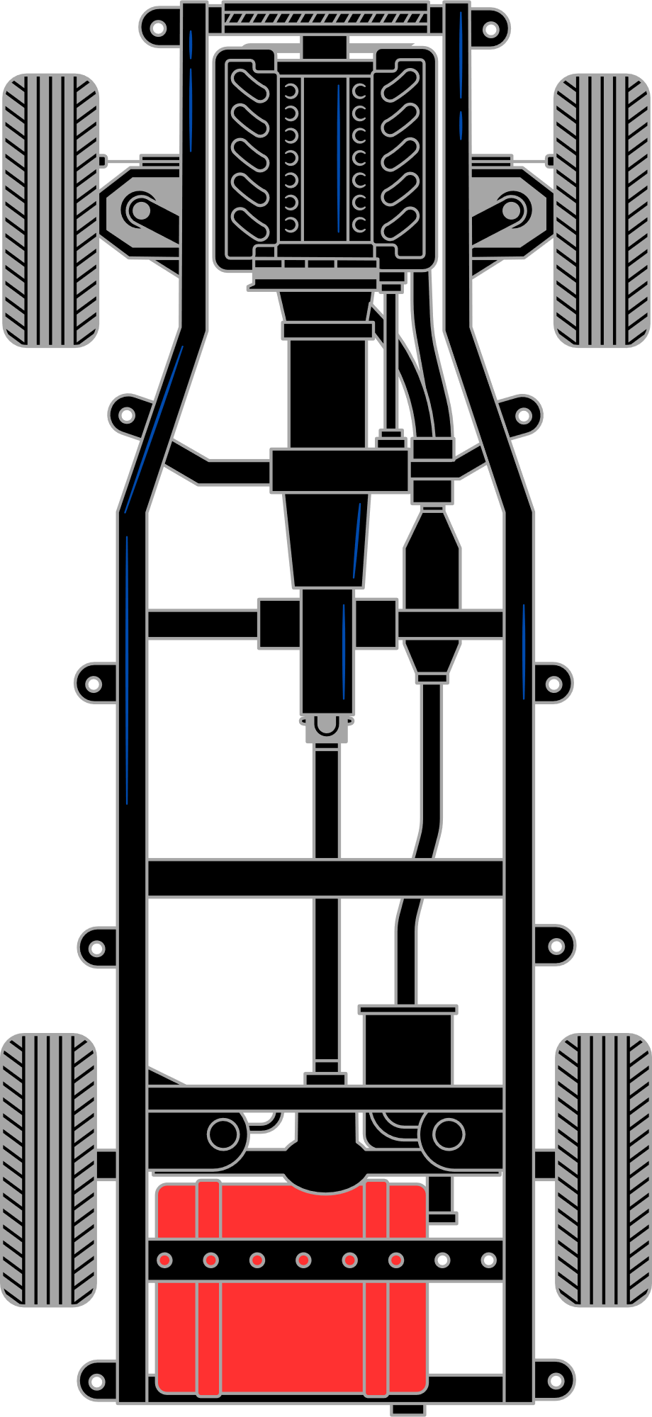
PROJECT INTRODUTION
Problem Statement:
Repair shops face delays in diagnosing vehicle issues due to manual inspections, leading to inefficiencies, lost revenue, and reduced customer satisfaction. The lack of immediate insights into probable issues and repair estimates further impacts operations and competitiveness.
Goal:
Build a working prototype of an AI engine that predicts car issues and suggests repair recommendations based on historic data.
Business Impact:
At least 85% prediction accuracy.
20% reduction in diagnostic time.
Better customer satisfaction and cost savings
Patent #9111264 Focus:
Uses historical repair data to predict issues by linking symptoms, diagnostics, and successful repairs.
Why It Matters:
Helps repair shops diagnose problems faster and more accurately.
Reduces diagnostic time and unnecessary repair costs.
2

Slide 3


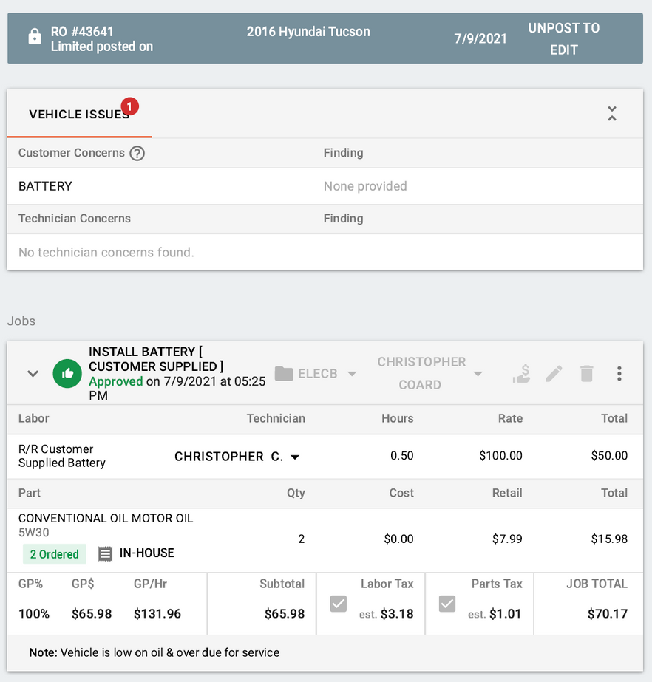
DATA OVERVIEW
Data provided by sponsor:
6184 Invoice PFD files
Key fields in PDFs:
Inovice Number
Vehicle Information
Customer Concerns & Finding
Technician Concerns & Finding
Jobs:
Labor
Parts
Cost breakdown
Total cost breakdown
3

Slide 4
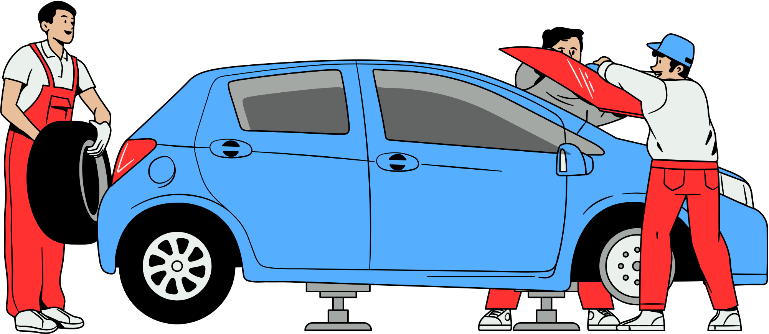
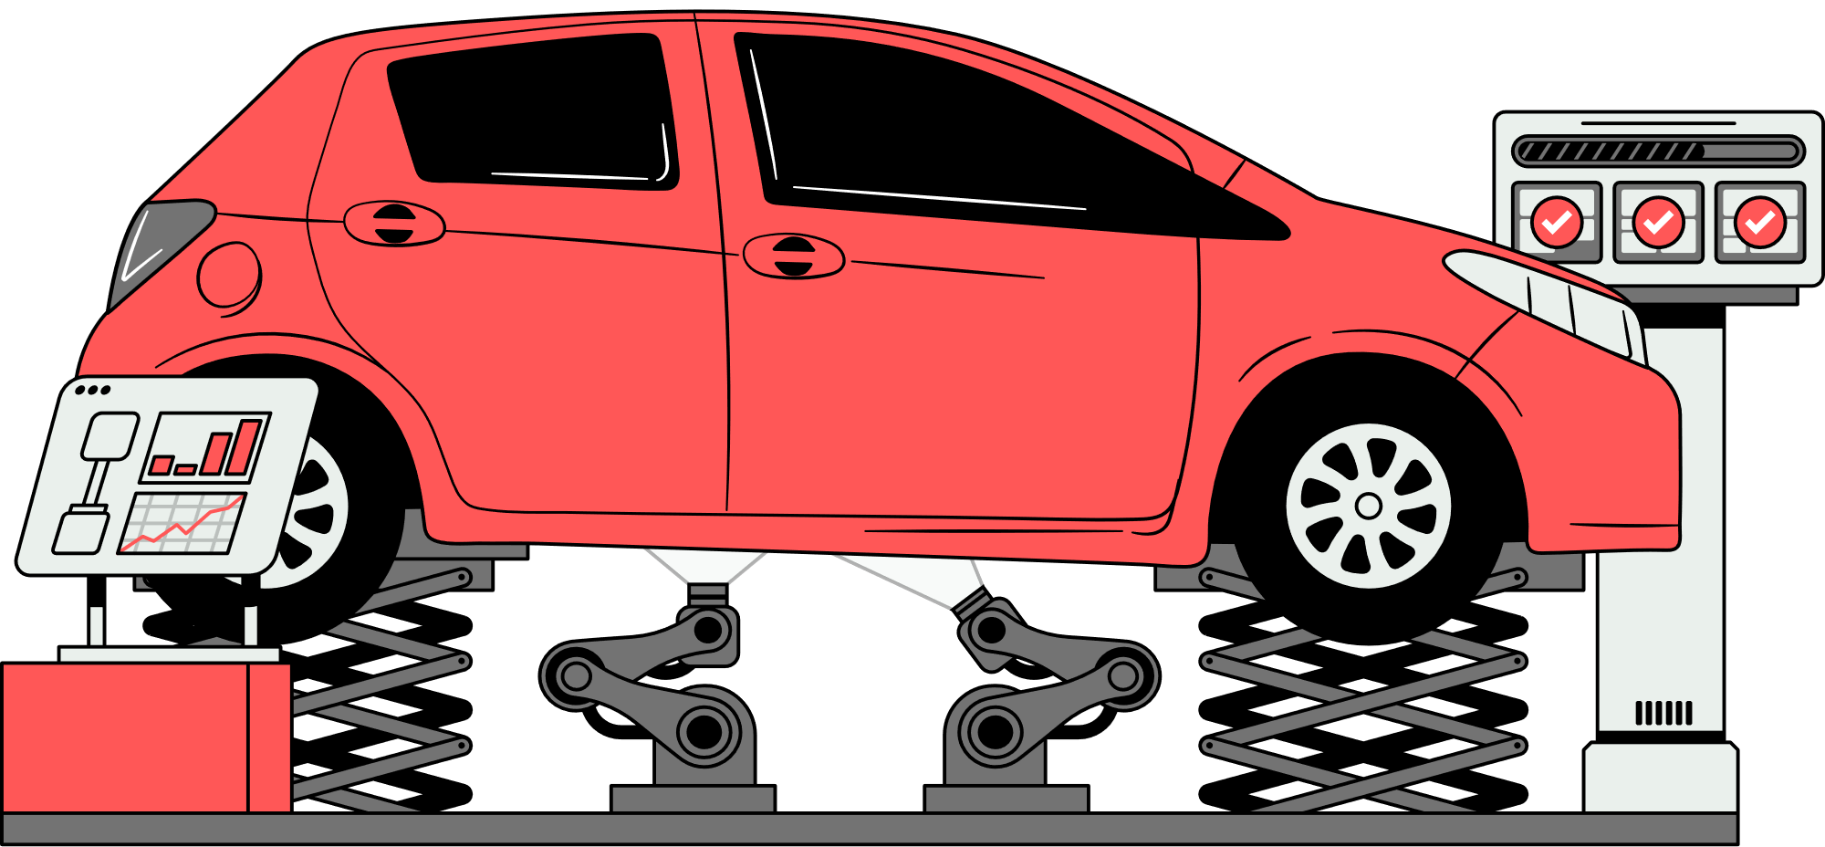
KEY OBJECTIVE
Data Extraction
Data Cleaning
Data Clustering
Building Model
Prototype
4

Slide 5
DATA EXTRACTION
Utilized pdfplumber to extract data for all 6,184 PDF files.
Applied regex patterns to capture key details such as:
Invoice Number
Make, Model, Year, Mileage, VIN, License Plate
Customer Concern & Finding
Jobs (Labor + Parts+ Cost)
Total Amount and Labor Time
DTC Code
Employed RapidFuzz to detect and correct typos and inconsistencies.
Used LLM to normalize the user concerns and group them in different car repair categories
Converted to .json for modeling
5

Slide 6
INCOICE_DATA_FINAL.JSON
{{
"repair_order": {
"Invoice Number": 43757,
"vehicle_info": {
"make": "Subaru",
"model": "Impreza",
"year": 2017,
"mileage": 79406,
"VIN": "4S3GTAA62H3748791",
"License Plate": "AL37737CT"
},
"billing_info": {
"labor_time": 1.5,
"labor_cost": 150.0,
"total_amount": 454.98
},
"customer_concerns": [
{
"concern": "brake squeak",
"normalized_concern": "Brake squeaking noise",
"group": "Noise / Vibration"
}
],
"jobs": [
{
"description": "rr rear pads rotors",
"parts": [
{
"name": "rear brake pad set premium brake pad set10303 ceramic brake pads",
"cost": 99.99
},
{
"name": "rear brake rotors premium brake rotors103gnd coated hat rotors when available",
"cost": 150.0
},
{
"name": "caliper slide service"
}
]
}
]
}
},
6

Slide 7
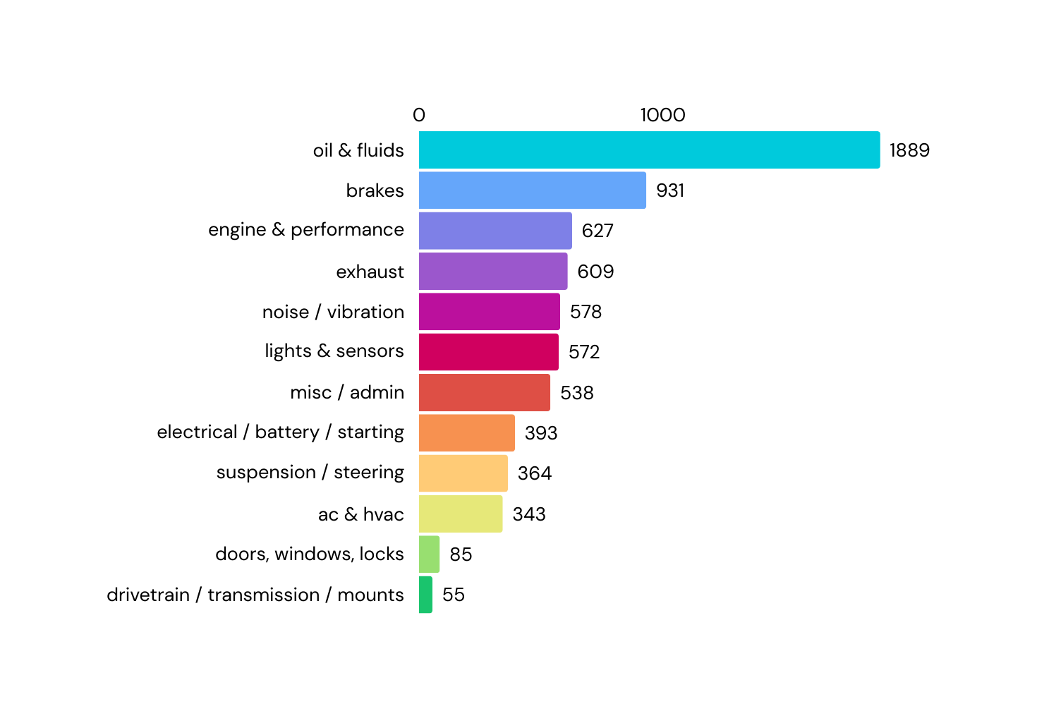
REPAIR MARKET ANALYSIS
This categorization of ~8,000 customer concerns into 12 standardized groups enables more accurate diagnosis, better trend analysis, and smarter repair recommendations.
The most frequently reported issues fall under “Oil & Fluids”, “Brakes”, and “Engine & Performance”, reflecting routine maintenance and common wear-and-tear concerns.
Less frequent categories like “Drivetrain / Transmission / Mounts” and “Doors, Windows, Locks” represent rare but high-impact problems, often linked to expensive repairs or safety-critical failures.
7

Slide 8
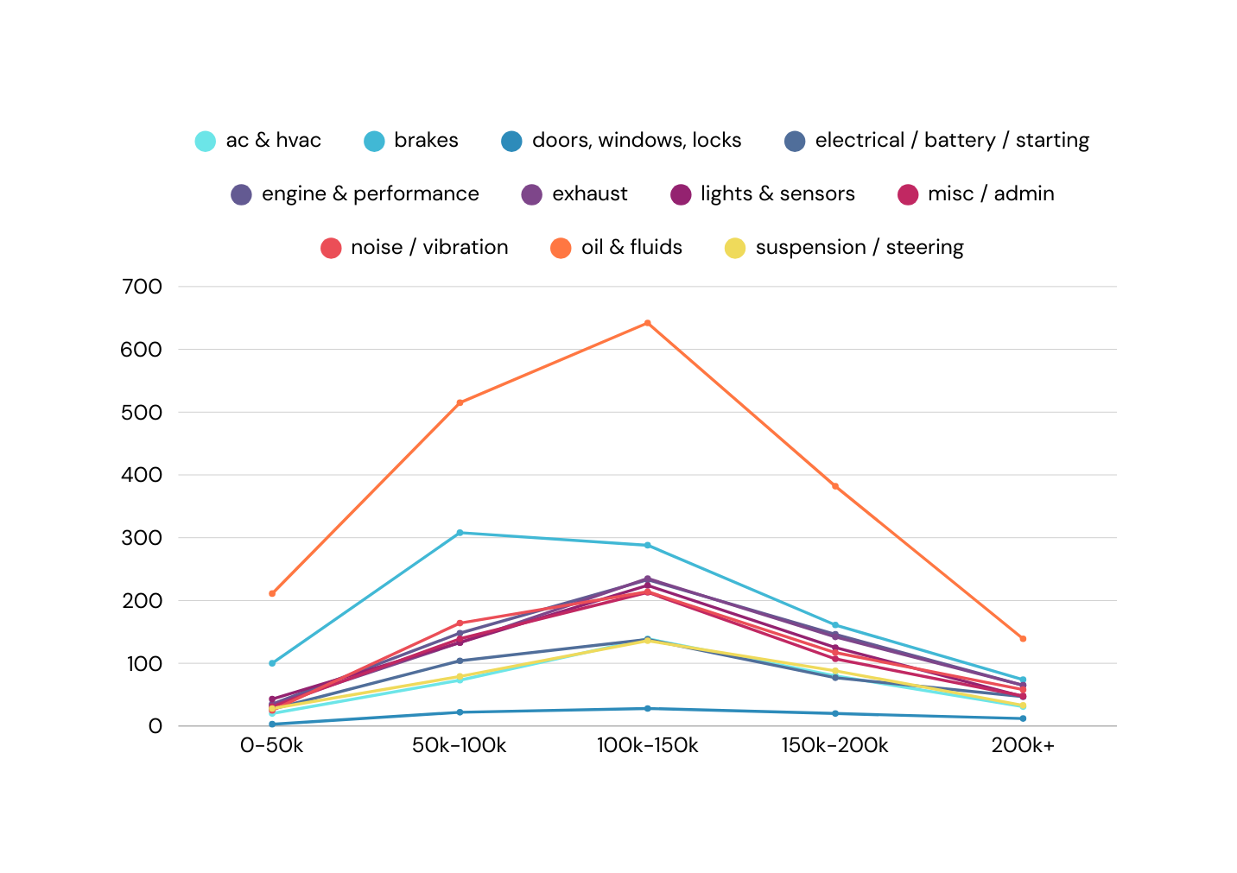
REPAIR MARKET ANALYSIS
Oil & Fluids concerns dominate across all mileage ranges, especially peaking at 100k–150k miles, indicating routine maintenance remains critical throughout a vehicle’s life.
Brakes see a sharp rise from 0–100k miles, then gradually decline, reflecting typical brake wear and replacement cycles in early to mid vehicle life.
Suspension / Steering and Noise / Vibration peak at 100k–150k miles, signaling increased chassis and handling issues as vehicles age.
Engine & Performance issues rise steadily and become significant after 100k miles, pointing to aging powertrain components needing diagnostics or major repairs.
8

Slide 9
RECOMMENDATION MODEL
Data Processing:
Extracted structured repair data including vehicle info, customer concerns, labor descriptions, part names, and part-level costs.
Cleaned and normalized part names (e.g., removed codes, vendor noise) for consistency.
Converted abbreviated labor descriptions (e.g., rr, fr) to user-friendly format (e.g., Rear, Front).
Embedding & Similarity Matching:
Used SentenceTransformer (all-mpnet-base-v2) for semantic embeddings.
Encoded customer concerns into vector space for similarity search.
Applied cosine similarity to find top historical matches filtered by vehicle make and model.
Recommendation Engine:
Identifies top 3 repairs based on most frequent similar concerns.
Aggregates average labor time (± std) from historical matches.
Surfaces top 3 parts per repair, with:
Confidence % (based on usage frequency)
Average Cost (directly pulled from part-level cost)
Filters out noisy jobs (e.g., diagnostic fee) to avoid non-actionable suggestions.
9

Slide 10
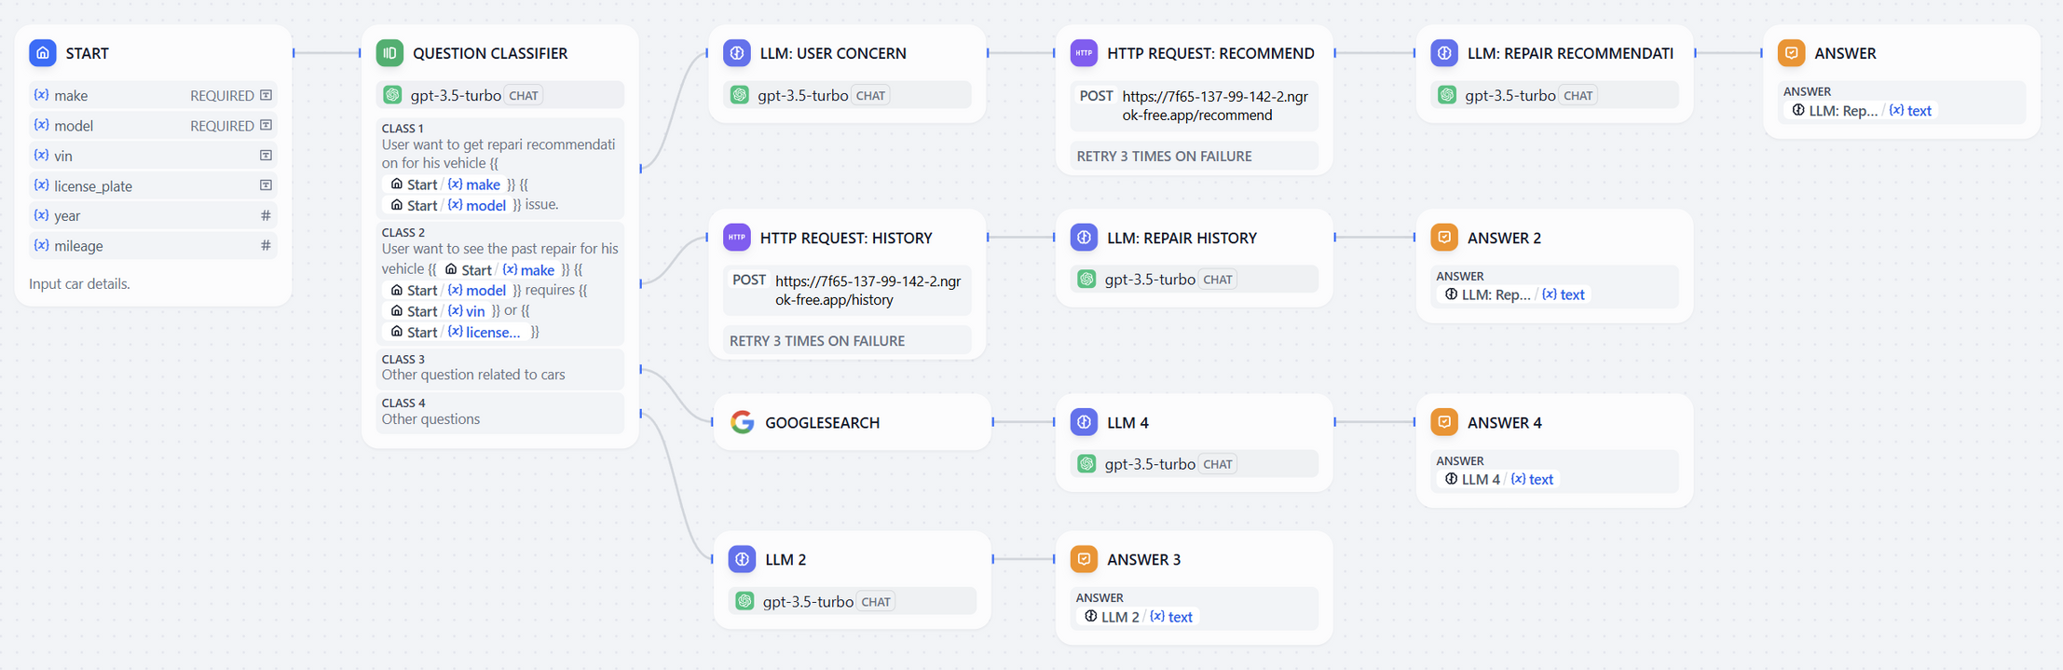
PROTOTYPE CHATFLOW
10

Slide 11
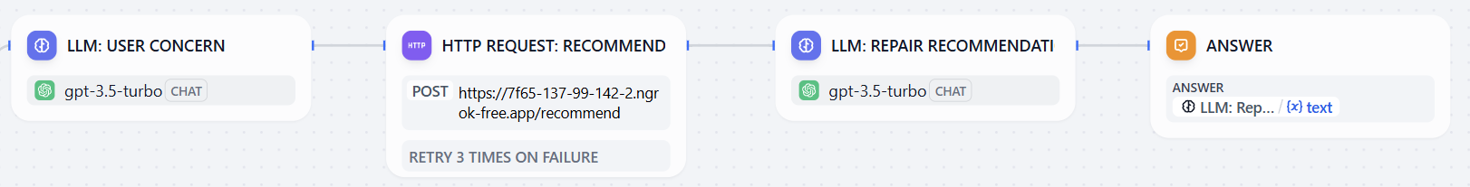
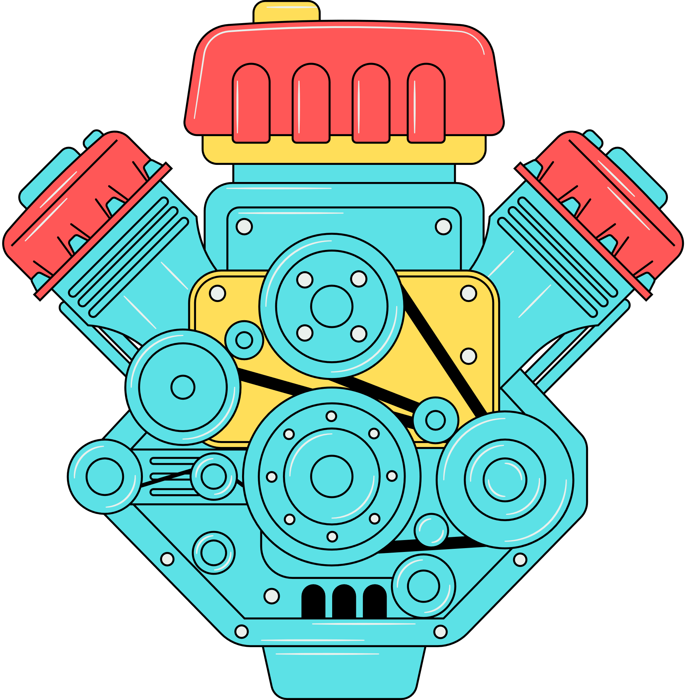
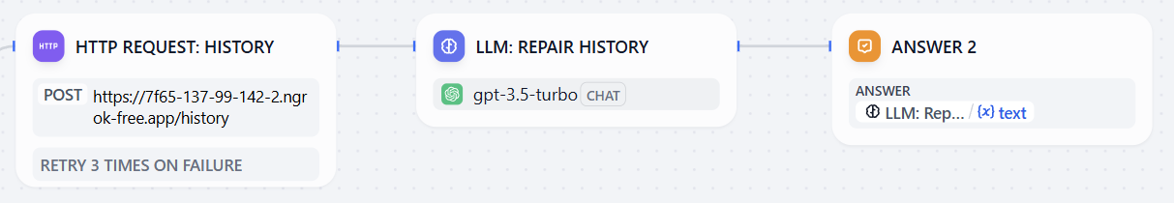
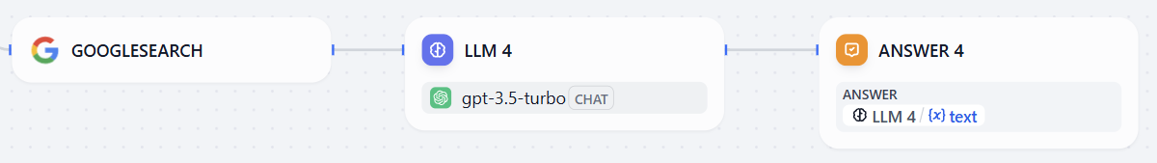
Application Feature 1: Smart Repair Recommendations
My engine is making a weird noise. What should I get checked?
How much will it cost to fix my car?
How long will it take to fix my car?
Application Feature 2: Repair History Lookup
Can you pull up the past repair history for my vehicle?
Application Feature 3: Vehicle Info & Manufacturer Insights
Can you tell me about the new Tesla Cybertruck?
11

Slide 12
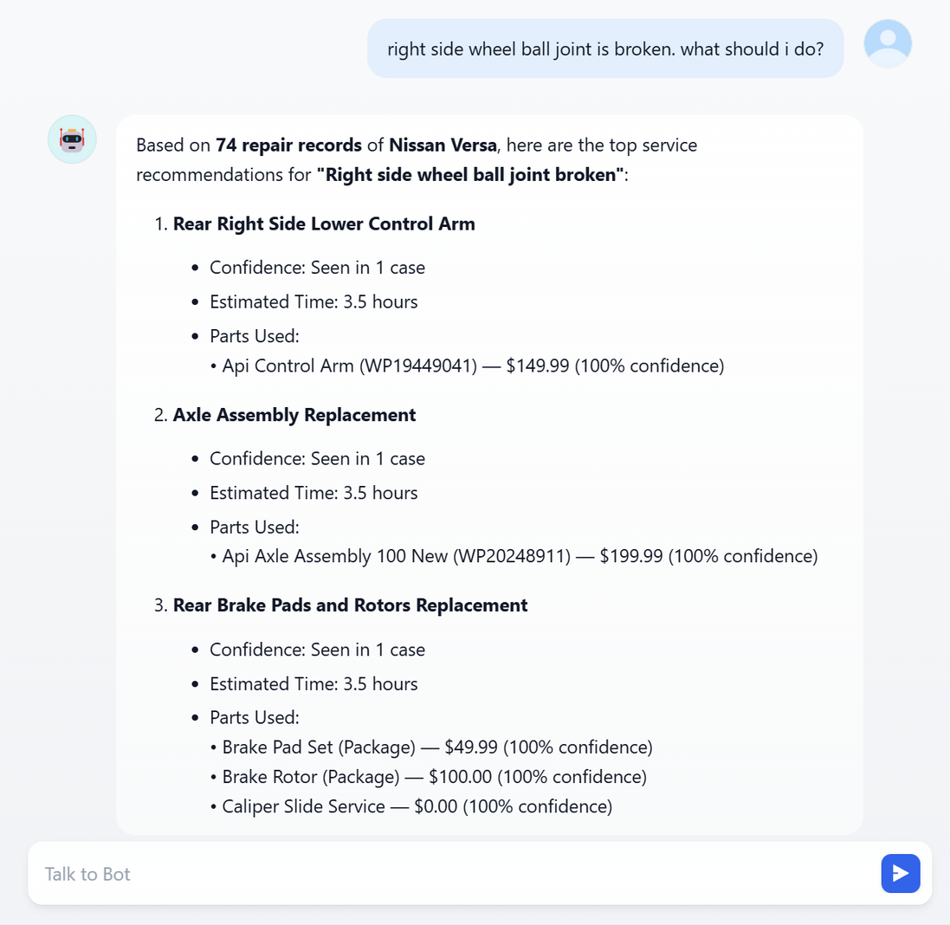
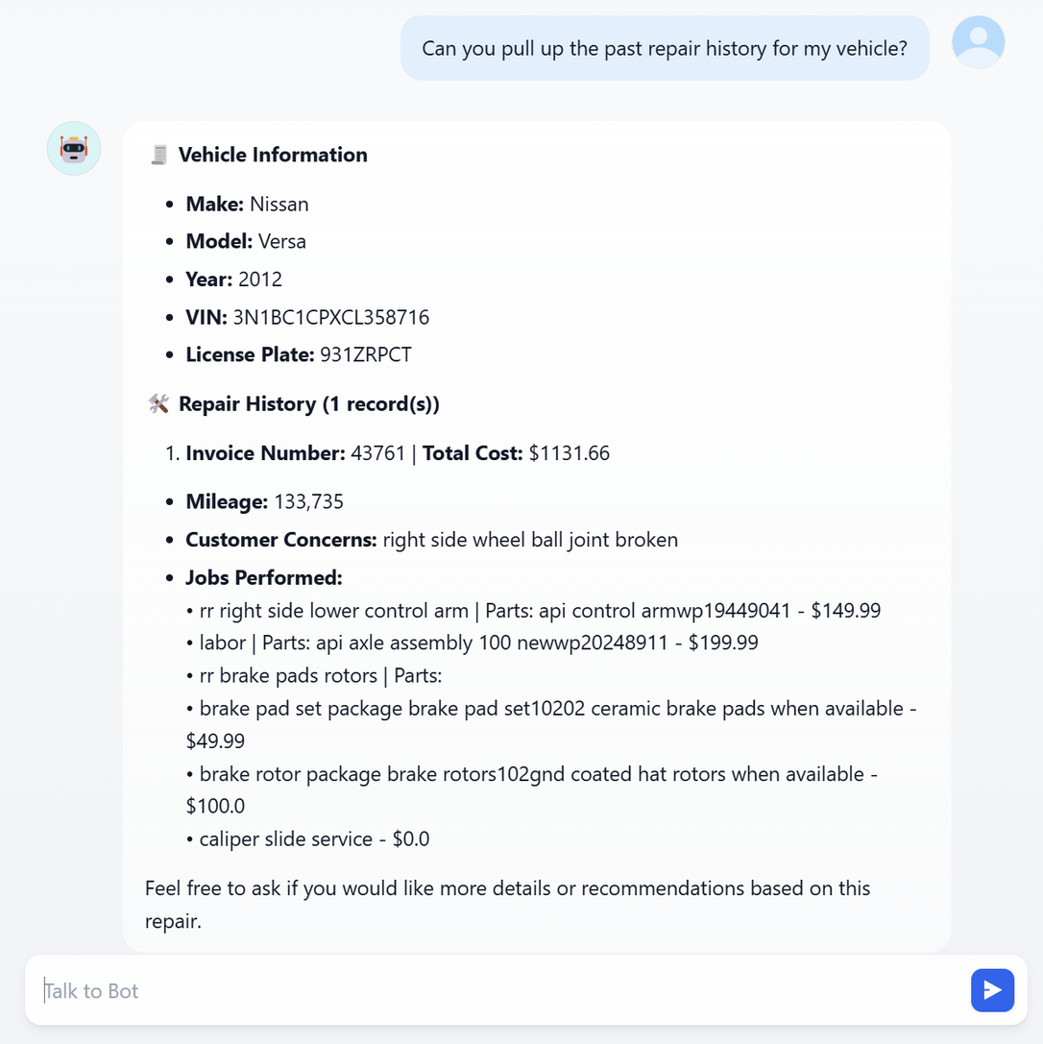
RESULTS
12

Slide 13
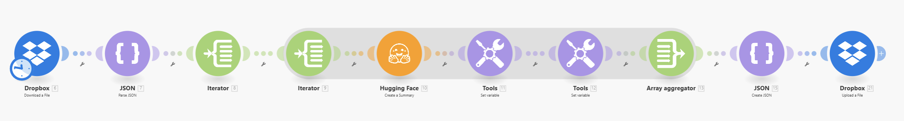
NEXT STEPS
Normalize Historical Concerns with LLM
Use sshleifer/distilbart-cnn-12-6 via Make.com (Make.ai) to clean and unify past customer concerns
Enables more accurate model predictions and reduces semantic mismatch
Pipeline ready but requires premium tokens
Live Integration with Tekmetric
Sync with Tekmetric’s API to fetch live repair records
Keeps database continuously updated with real-time customer concerns and repairs
Mobile App for Wider Access
Build an intuitive iOS/Android app for repair shops and customers
Offers on-the-go diagnosis, repair history access, and booking suggestions
Prepares AutoShopIQ for market readiness
13

Slide 14
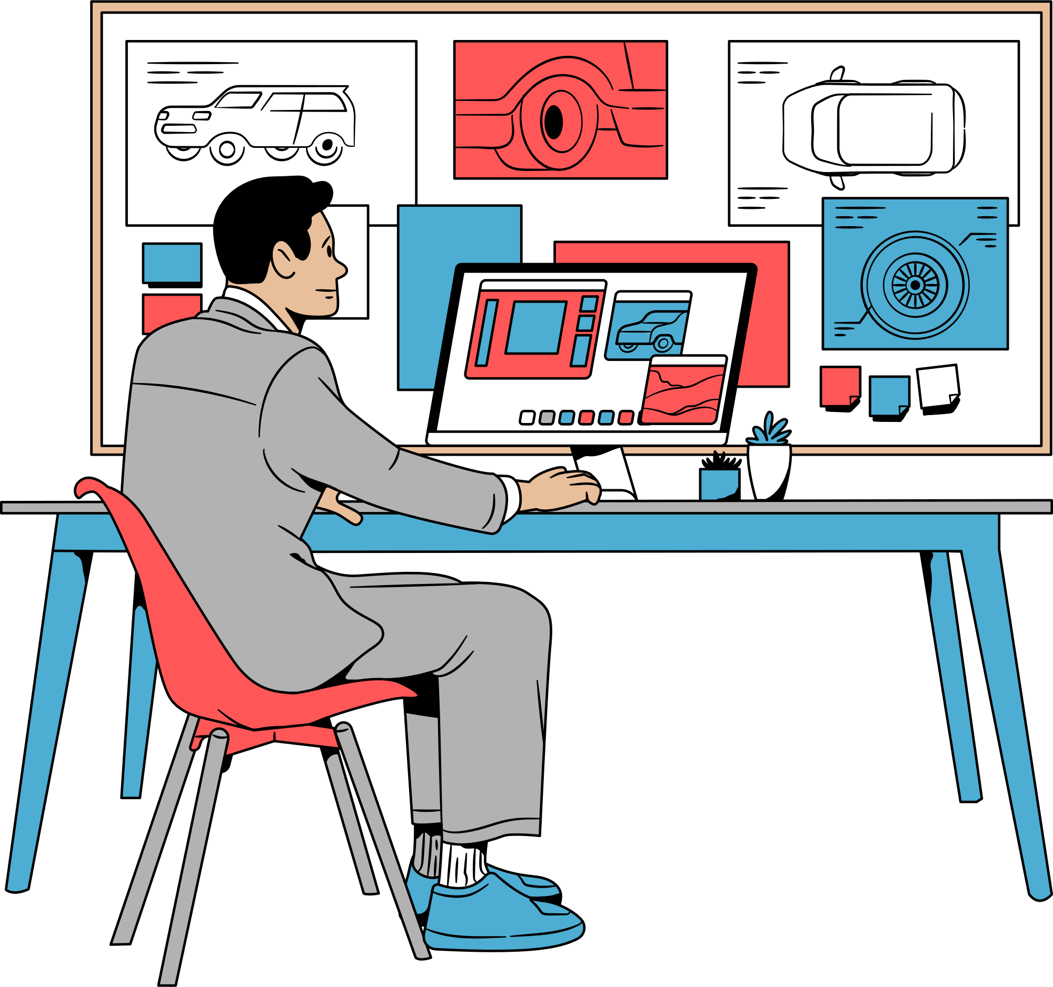
TOOLS & TECHNOLOGIES USED
🧠 AI & NLP
GPT-3.5 Turbo via Dify.ai for conversational repair assistant
Sentence Transformers (all-mpnet-base-v2) for semantic matching
sshleifer/distilbart-cnn-12-6 via Make.com (Make.ai) to automate customer concern normalization
📊 Data Processing & Modeling
Python (pandas, regex, numpy) for data cleaning & structuring
Cosine similarity + DBSCAN for concern clustering
Regex patterns for extracting vehicle/job details
🌐 Application Infrastructure
Flask API for repair recommendation backend
ngrok to expose local services for Dify integration
Streamlit for early-stage UI prototyping
🔍 Analytics & Visualization
matplotlib, seaborn for EDA: trends by mileage, year, and concern type
14

Slide 15
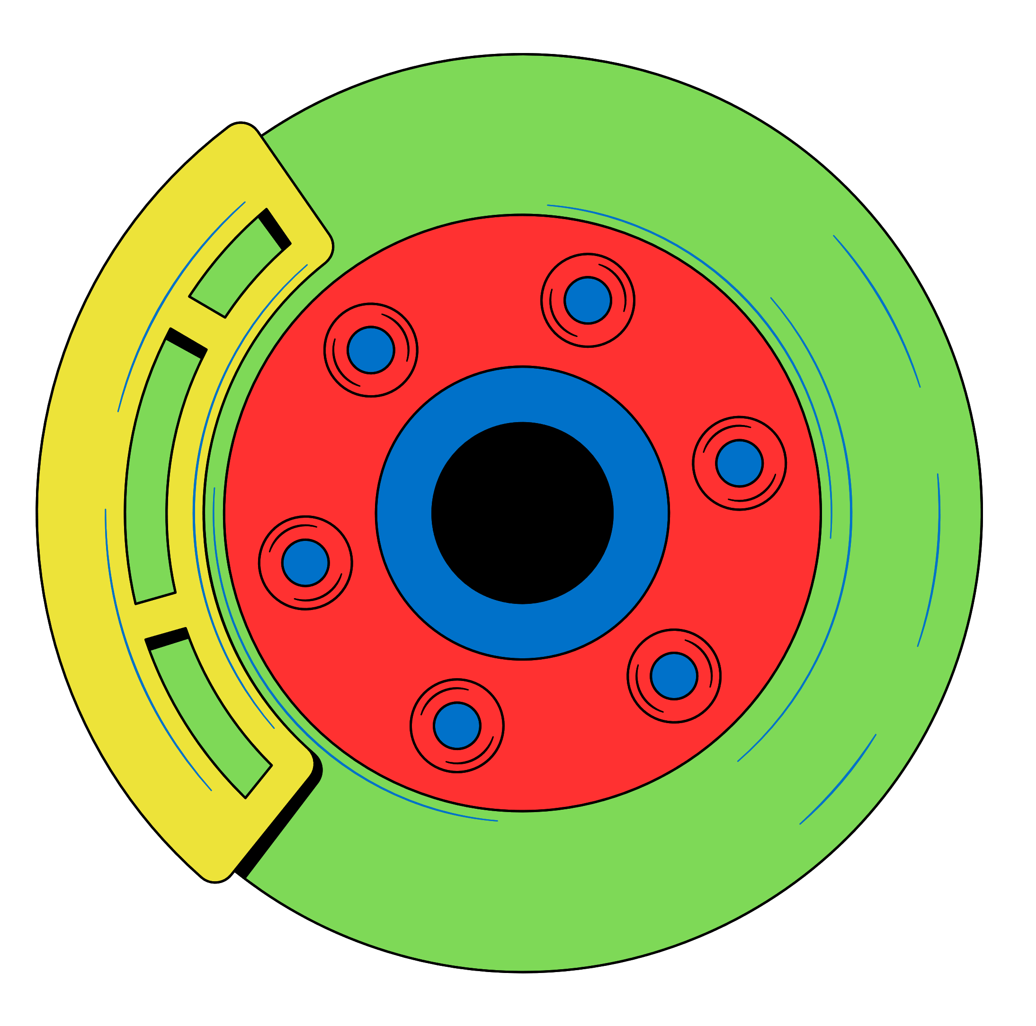
THANKYOU FOR WATCHING
🔗 Github: https://github.com/yash10parihar/AutoShopIQ.git
🔗 DIFY: https://udify.app/chat/T6MxcizqM3HRO8O2
🔗 Make: https://us2.make.com/699887/scenarios/1431597/edit
15

